Slide 1
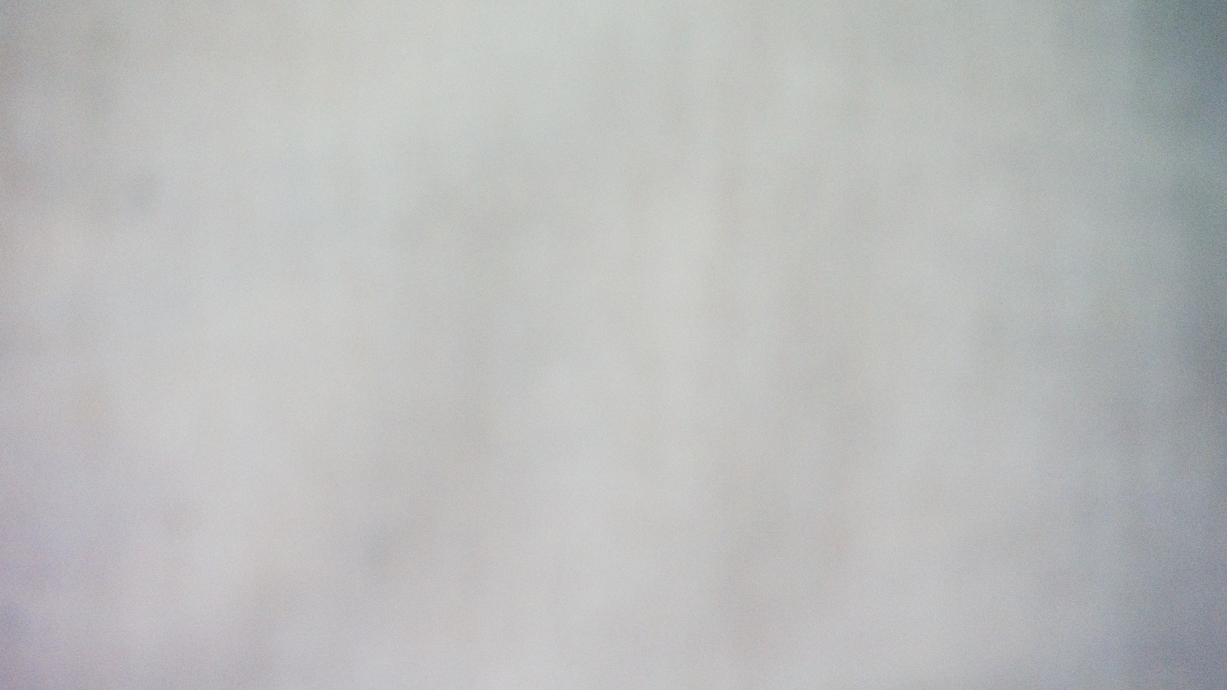
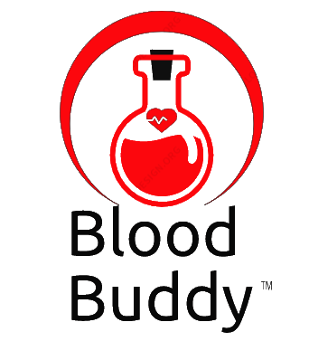
BLOOD BUDDY
Co-founders:
Sai Maneesh Reddy Kadire
Venkata Suchitra Varanasi
Sai Priya Anchuri
Rohith Babu Ginjupalli
Yaswanth Reddy Mallu

Slide 2

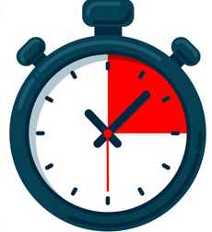
PAIN POINTS
Delay in time for finding donors.
Ineffective communications.
Blood can be stored for 42 days at 6˚C.
Complicated surgeries.
Social media assistance.

Slide 3
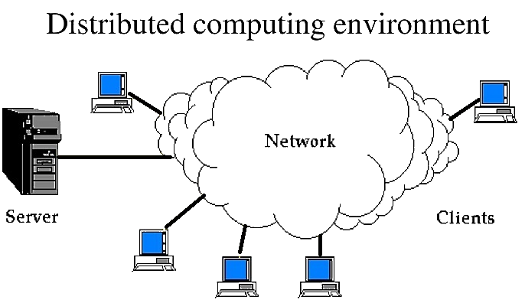
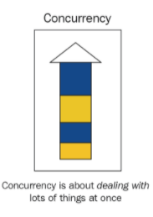
AI & DC CONCEPTS
Alerts & Notifications.
Security, Concurrency.
Heterogeneity, Scalability.

Slide 4
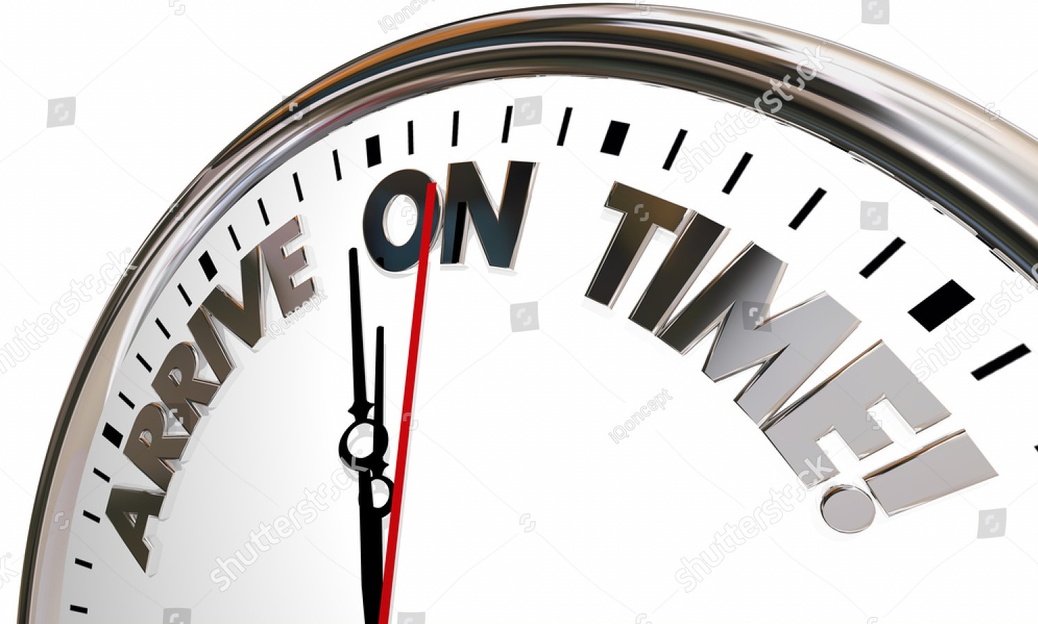
PAIN POINTS SOLUTION
Creating platform for donors and receivers/patients.
Blood will be on accurate time.
In emergency, guiding blood banks and trusts for help.

Slide 5





CURRENT APPS & LIMITATIONS
Current Applications:
American Red Cross (Blood Donor), Canadian Blood Services (Give Blood), Australian Red Cross Blood Life, Friends2Support, VMEDO.
Limitations:
Applications are only used for donors when they are willing to donate blood.
The receiver need to contact them, for blood which is the biggest limitation for Friends2support, VMEDO.
If in case, No donor near by receiver locations they did not provide any solutions for the problem.
CBS

Slide 6

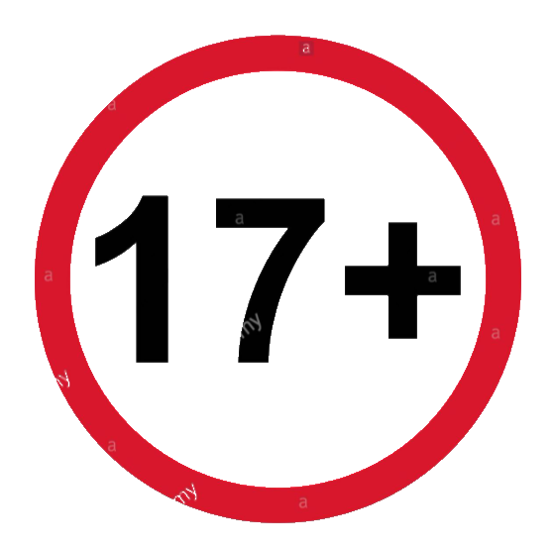
TARGET MARKET & VALUE PROPOSITIONS
Target Market:
Our app does not have any restriction on receivers or patients irrespective of age, location, income, lifestyle, gender and race.
But for donors we are targeted only greater than age 17, because legal age to donate blood is 17.
Value Propositions:
We promise that no life will be loss due to lack of blood. And we are maintaining punctuality as our key motto.
We promise that we will contact the blood banks and trust near by, If no donor is near by the receiver location.
We promise 2 free doctor consultations for donor if donor reaches to highest rank.
Only for Donors

Slide 7


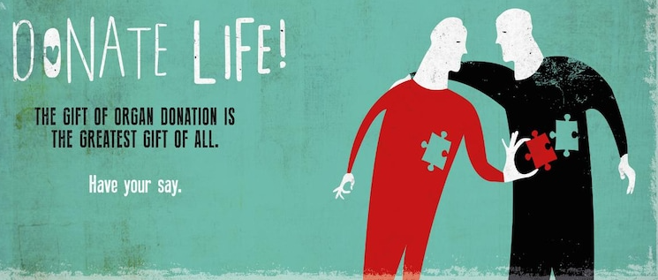
BUSINESS CYCLE & Making Money
Planning
Operations & Maintenance
Requirments
Deployment
Design & PROTOTYPING
Testing
Software Development
Making money by advertising and promotions, in particular medical appliances and blood donations camps and trusts.
And sharing our insights and revealing our future project which is extension of Blood donor app i.e., Organ Donor.

Slide 8
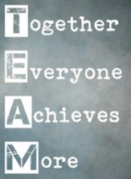
TEAM MEMBER & CONTRIBUTIONS
Manish Reddy -- Architecture & Backend using Java.
Rohith Babu -- Idea & Architecture.
Suchitra – UI & Presentation.
Sai Priya – Framework & Testing
Yashwanth – Database & Admin
We named our team as DC Dynamites. We are 5 in team; we feel lucky to form a team.
Everyone in team have working experience which helps team to solve real time scenarios.
Our main motto is grow together, everyone in team will motivating each other and sharing information.

Slide 9
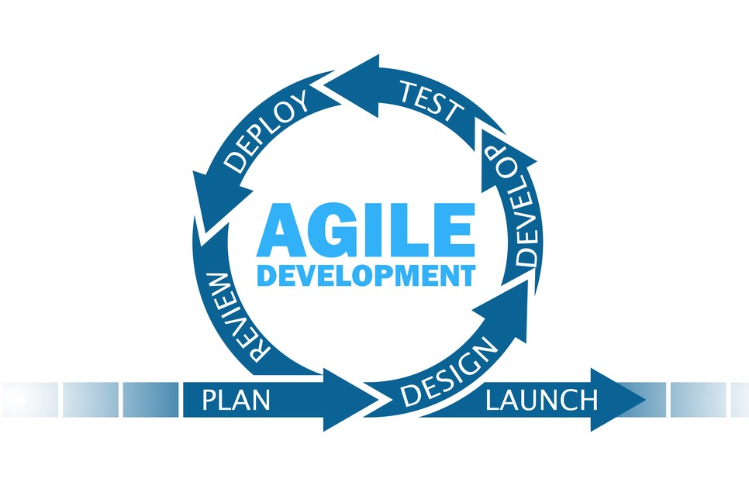
DESIGN PLAN & DEVELOPMENT
UI
(API GATE WAY)
SERVER
DATABASE
We are planning to use AGILE method of development.
We are planning to use UNIT testing method for application validations.

